Slide 1

Apache Flume
By
Vinil Kumar Kamigari

Slide 2
Overview
What is flume?
Event Data Flow Model
Network Streams
Complex Flows
Setting up Agent
Conclusion

Slide 3
What is flume?
Apache Flume is a distributed, reliable, and available system for efficiently collecting, aggregating and moving large amounts of log data from many different sources to a centralized data store.
The use of Apache Flume is not only restricted to log data aggregation. Since data sources are customizable, Flume can be used to transport massive quantities of event data.

Slide 4
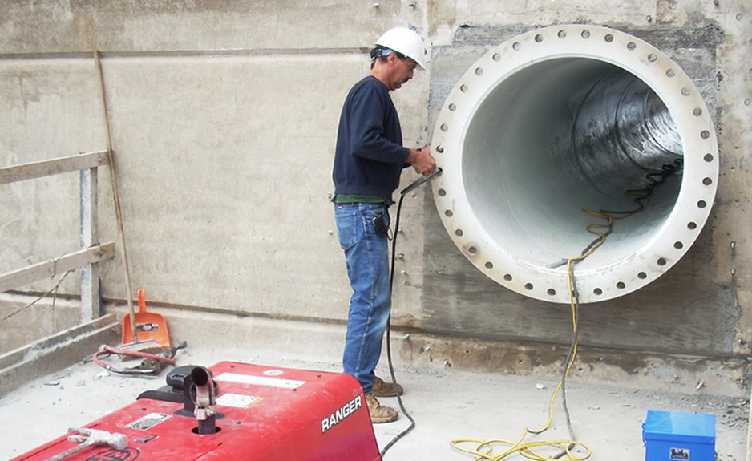
What is flume?
A flume is a channel that directs water from a source to some other location where water is needed.

Slide 5
Event Data Flow Model
A Flume event is defined as a unit of data flow having a byte payload and an optional set of string attributes. A Flume agent is a (JVM) process that hosts the components through which events flow from an external source to the next destination (hop).

Slide 6
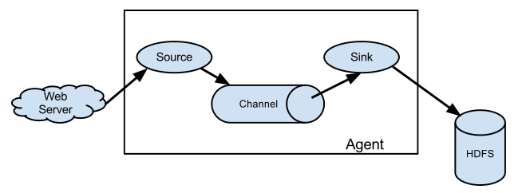
Event Data Flow Model Contd.

Slide 7
Network Streams
Flume supports the following mechanisms to read data from popular log stream types, such as:
Avro
Thrift
Syslog
Netcat

Slide 8
Complex flows
Flume allows a user to build multi-hop flows where events travel through multiple agents before reaching the final destination. It also allows fan-in and fan-out flows, contextual routing and backup routes (fail-over) for failed hops

Slide 9
Setting up Flume Agent
Flume agent configuration is stored in a local configuration file. This is a text file which has a format follows the Java properties file format. Configurations for one or more agents can be specified in the same configuration file. The configuration file includes properties of each source, sink and channel in an agent and how they are wired together to form data flows.

Slide 10
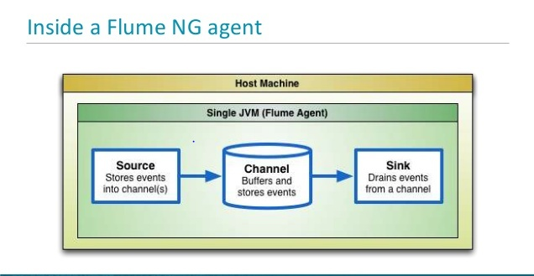
Process Event Listening using Flume

Slide 11
Configuring Individual Components
Each component (source, sink or channel) in the flow has a name, type, and set of properties that are specific to the type and instantiation. For example, an Avro source needs a hostname (or IP address) and a port number to receive data from. A memory channel can have max queue size (“capacity”), and an HDFS sink needs to know the file system URI, path to create files, frequency of file rotation (“hdfs.rollInterval”) etc. All such attributes of a component needs to be set in the properties file of the hosting Flume agent.

Slide 12
Starting Agent
This is the command we give for starting the Flume Agent.

Slide 13
Conclusion
Flume is helpful for
Distributed data collection service.
Suitable Enterprise Setting.
Large amount of event or data log for processing.

Slide 14


